Slide 1
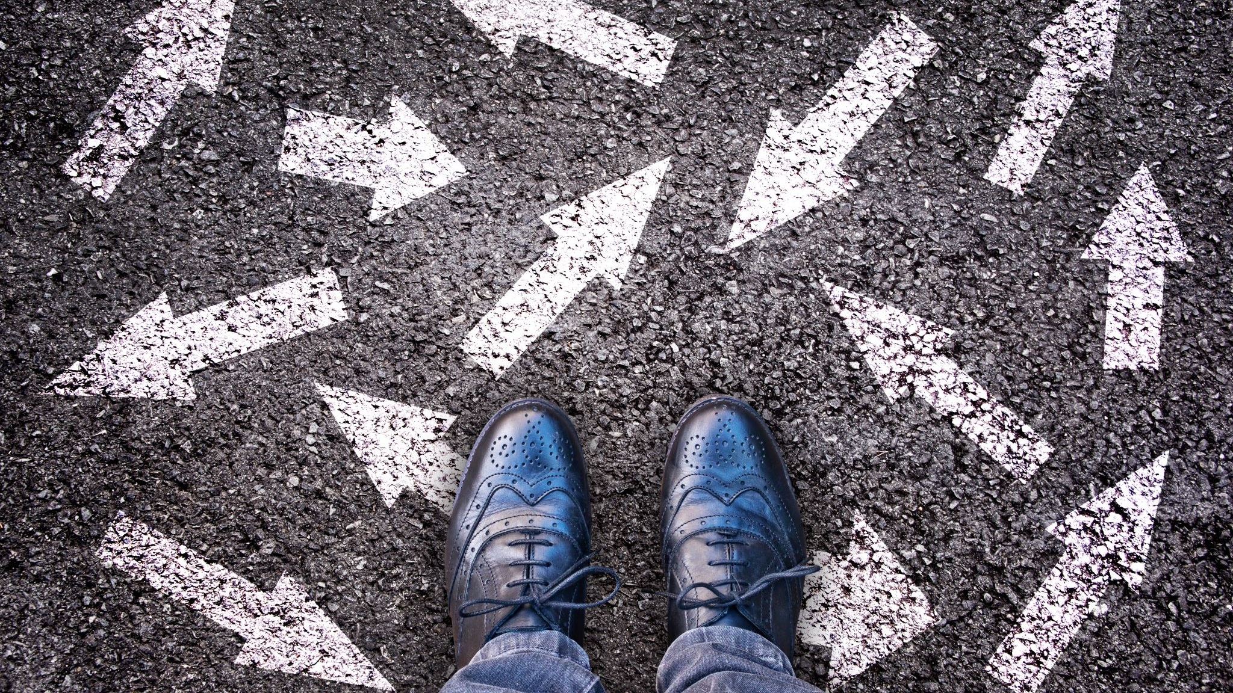

INTRODUCTION
TO
OpenCV
Pranav Suresh (MnC) Somya Bansal (CSE)

Slide 2
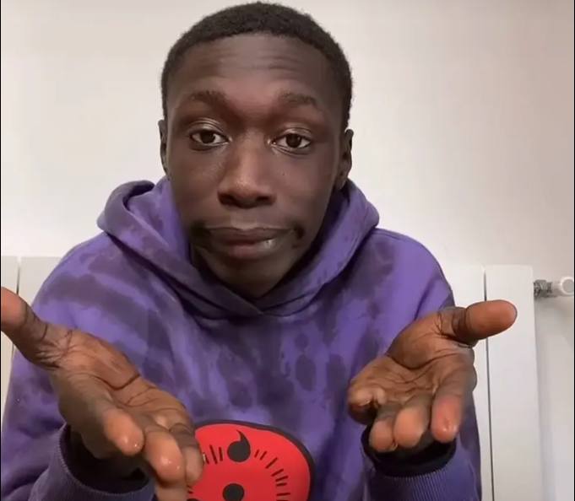
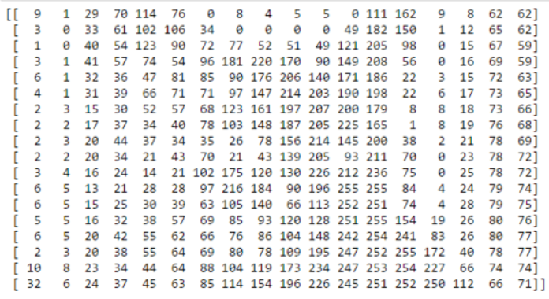
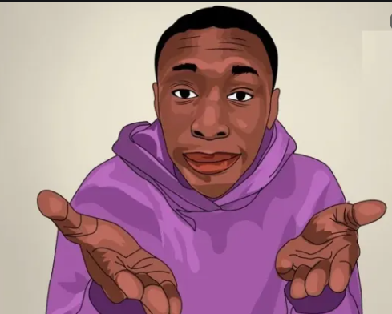
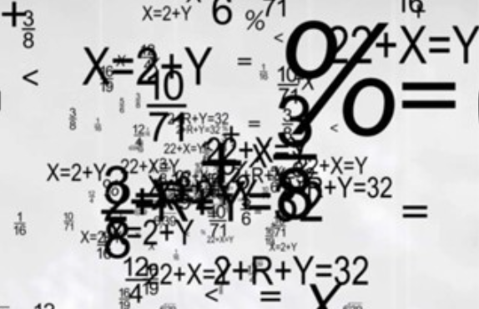
Image Processing:
Input Image
Conversion into digital form
Output
Analysis and Manipulation

Slide 3

OpenCV
OpenCV is an Image Processing library created by Intel.
Available for C, C++, and Python.
Open Source and free.

Slide 4
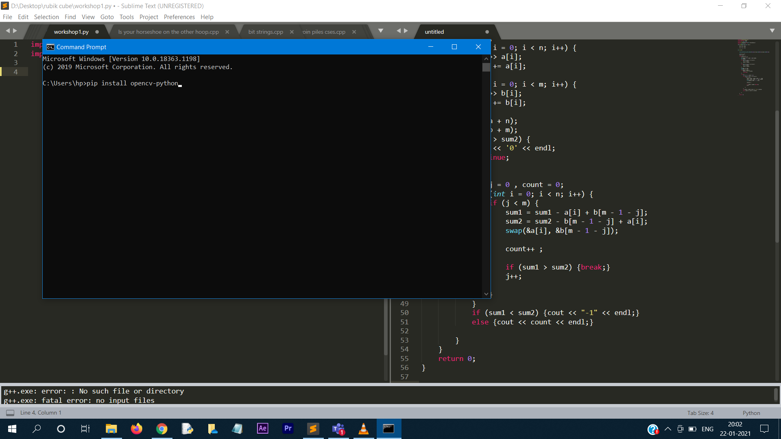
HOW TO INSTALL OPEN-CV IN WINDOWS
Type pip install opencv-python in Command prompt

Slide 5
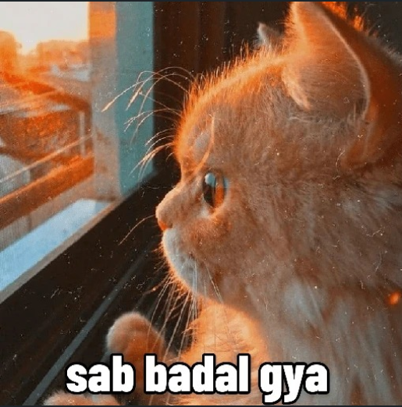
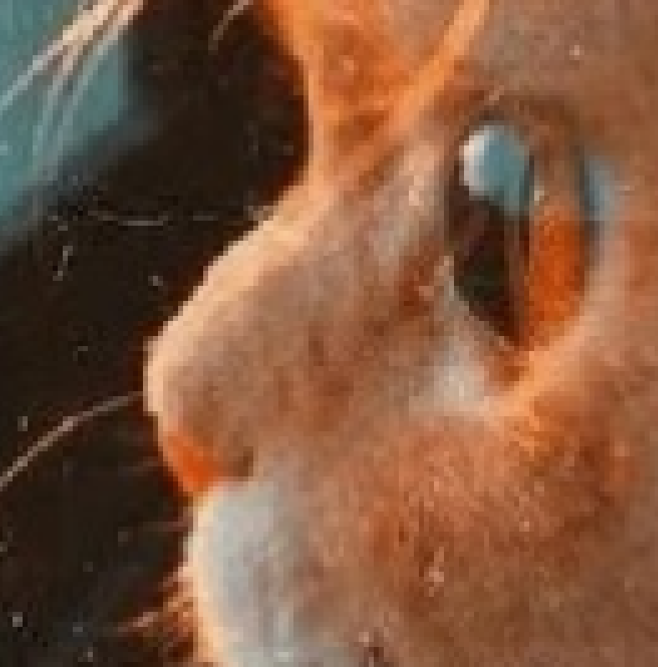
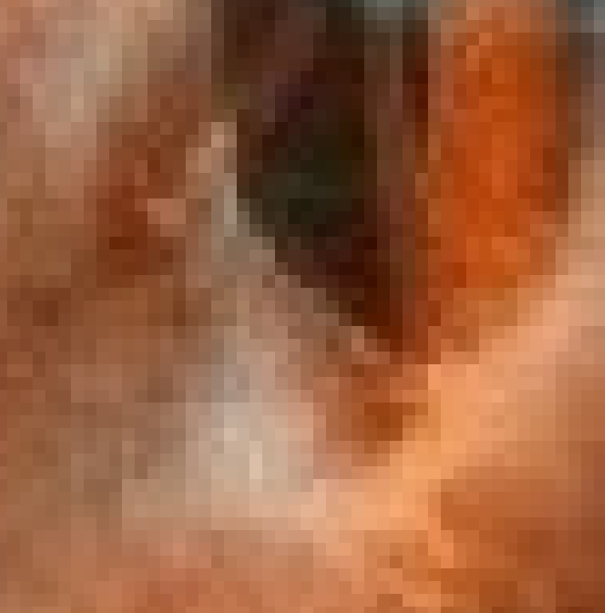
Pixels in Images:

Slide 6
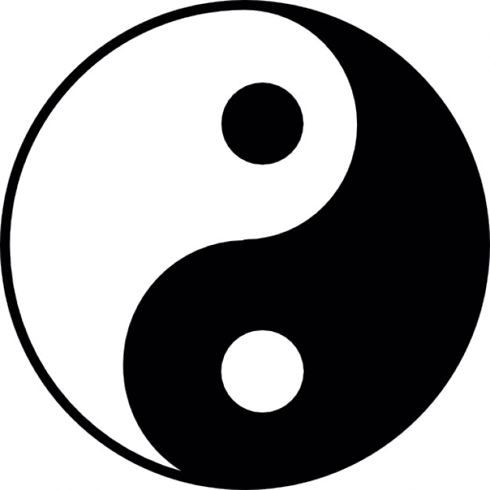
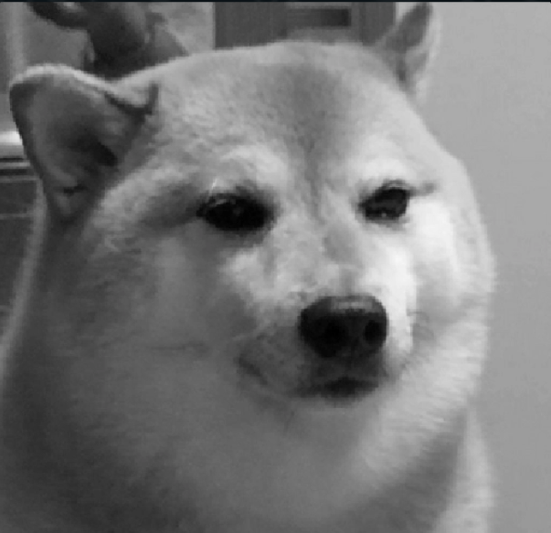
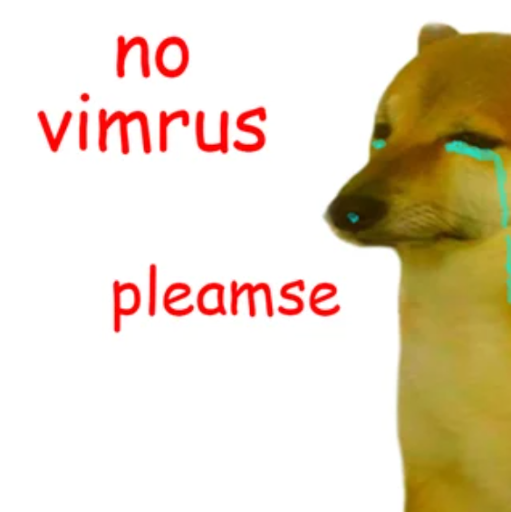
Types of Images:
Binary Image
Grayscale Image
RGB Image

Slide 7
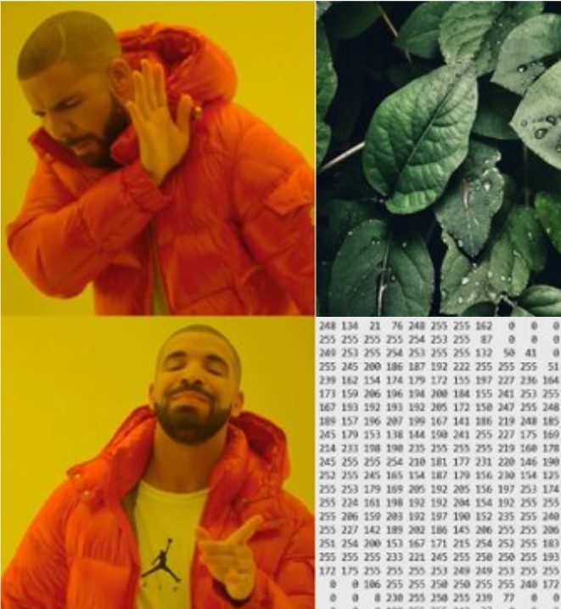
Images in OpenCV:
An image is stored as a numpy array
Dimensions = number of pixel rows
x number of pixel columns x number of channels.
The indexing in an image is (y,x) or (row,column).
Each pixel has some intensity.
Each element of the array contains the value of this intensity at the corresponding pixel.

Slide 8
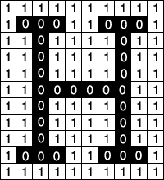
Binary Image: Array of 0’s and 1’s
0 → black; 1 → white

Slide 9
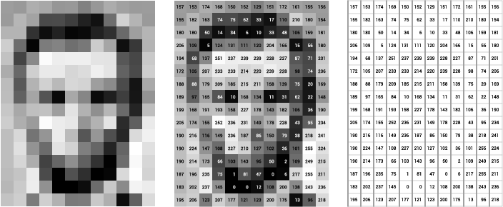
Grayscale Image: Array with values 0 to 255
0 → black; 255 → white
Intermediate values → shades of grey

Slide 10
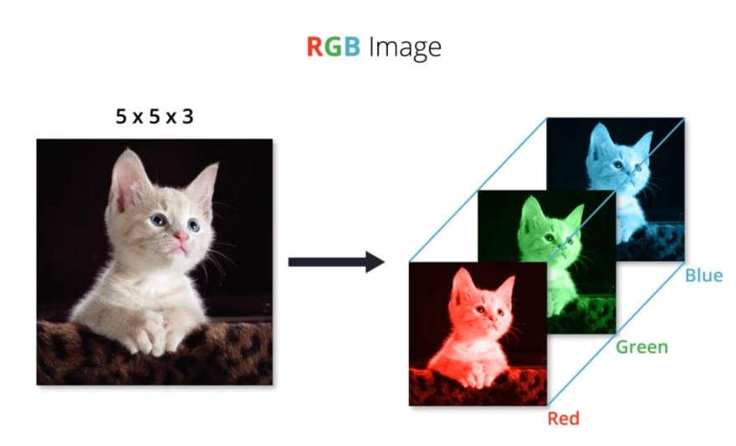
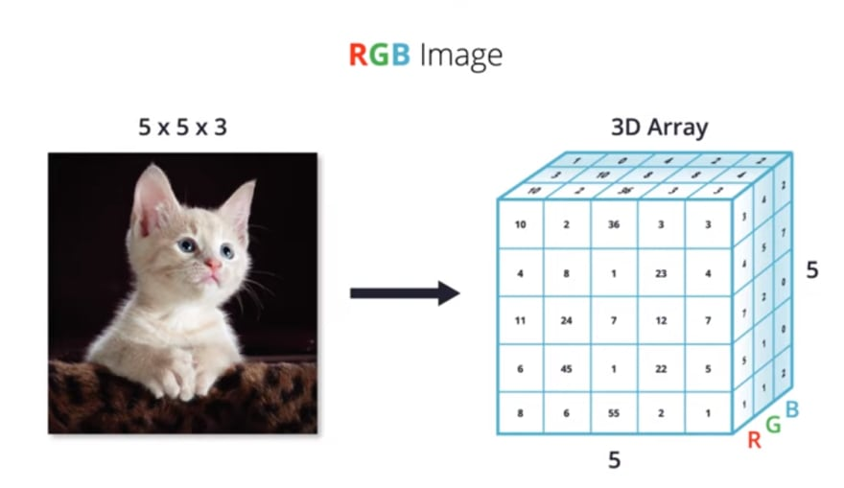
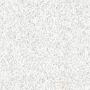
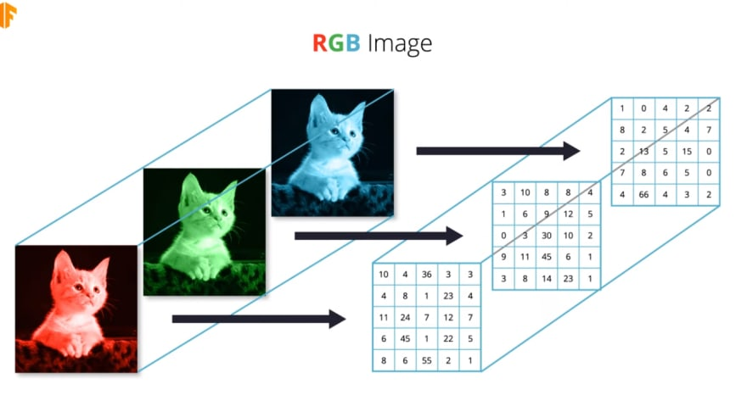
RGB Image: 3D Array with values 0 to 255
Each color has a specific RGB value
3D matrix: 1st plane → Red channel
2nd plane → Green channel 3rd plane → Blue channel

Slide 11
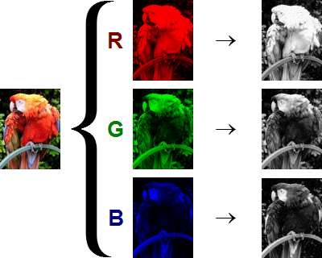
Each channel can be represented as a separate grayscaled image.

Slide 12
cv2.imread() : Read the image
image = cv2.imread(‘C:/path_to_image/image_name.png’, flag)
First Argument: Full/Relative path to the image.
Second Argument: A flag which specifies the way image should be read.
cv2.IMREAD_COLOR Flag: 1
cv2.IMREAD_GRAYSCALE Flag: 0
cv2.IMREAD_UNCHANGED Flag: -1

Slide 13
cv2.imshow() : Display the image
image = cv2.imread(‘C:/path_to_image/image_name.png’, flag)
cv2.imshow(‘window_name’, image)
cv2.waitKey(0)
cv2.destroyAllWindows()
cv2.waitKey(n) → Image is displayed for n milliseconds and then automatically closes.
cv2.waitKey(0) → Image is rendered until you close it manually.

Slide 14
cv2.imwrite() : Saves the image
cv2.imwrite(‘image.png’, img)
First Argument: Name of the image file
Second Argument: Array form of the image
This will save the image in PNG format in the working directory.

Slide 15
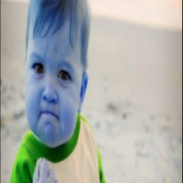
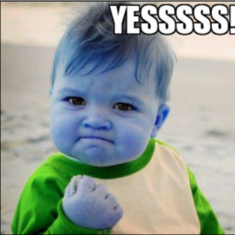
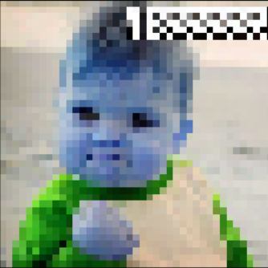
Resizing and Cropping

Slide 16
Resizing and Cropping
new_img = cv2.resize(old_img, (new_x, new_y)) #to a given size new_img = cv2.resize(old_img, (0, 0), fx = 0.5, fy = 0.5) #to a given scale
Resizing is done by cv2.resize() function with arguments as image and shape of desired image.
cropped_img = img[10:900, 120:700] #first y, then x
Cropping is done using NumPy slicing.

Slide 17
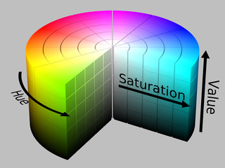
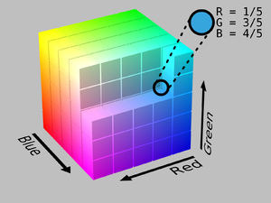
COLOR SPACES
HSV
RGB

Slide 18
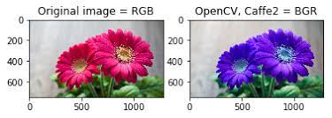
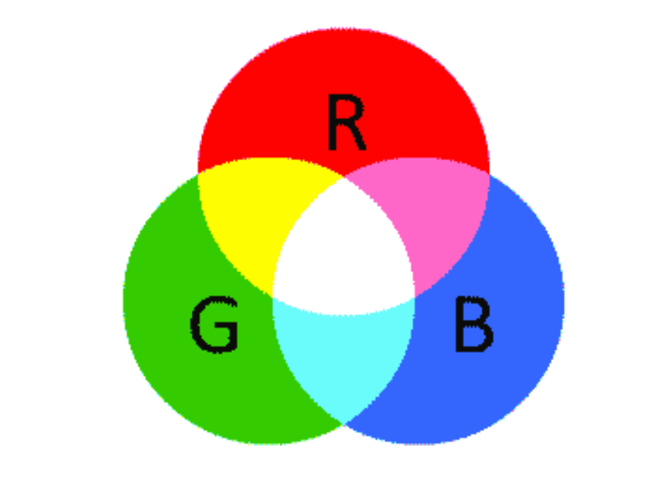
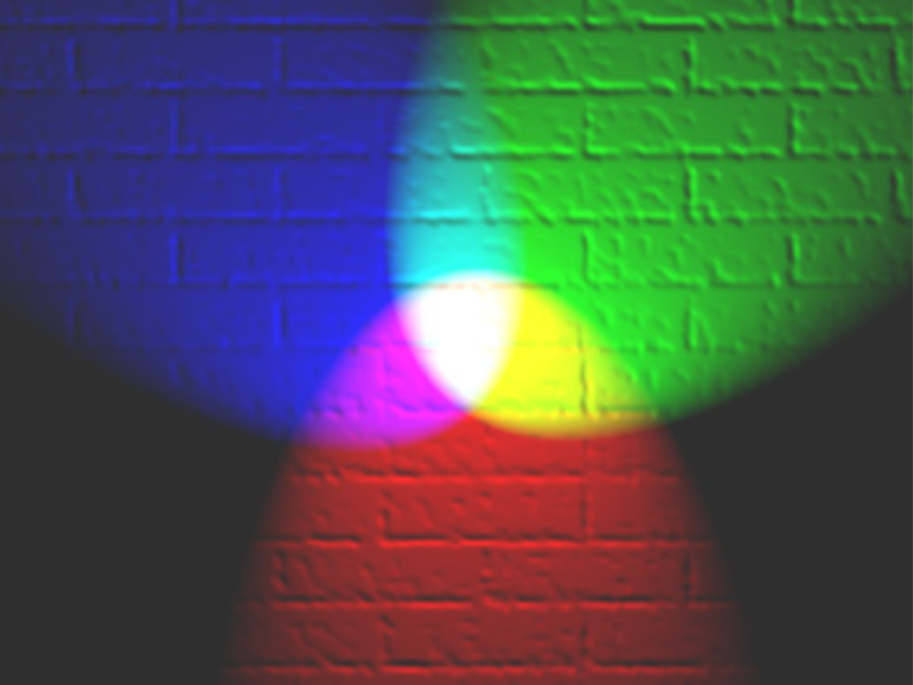
RGB … wait BGR color space
Default color space: RGB
Additive color model: colors are generated by adding values of R, G and B
OpenCV stores images in BGR format

Slide 19
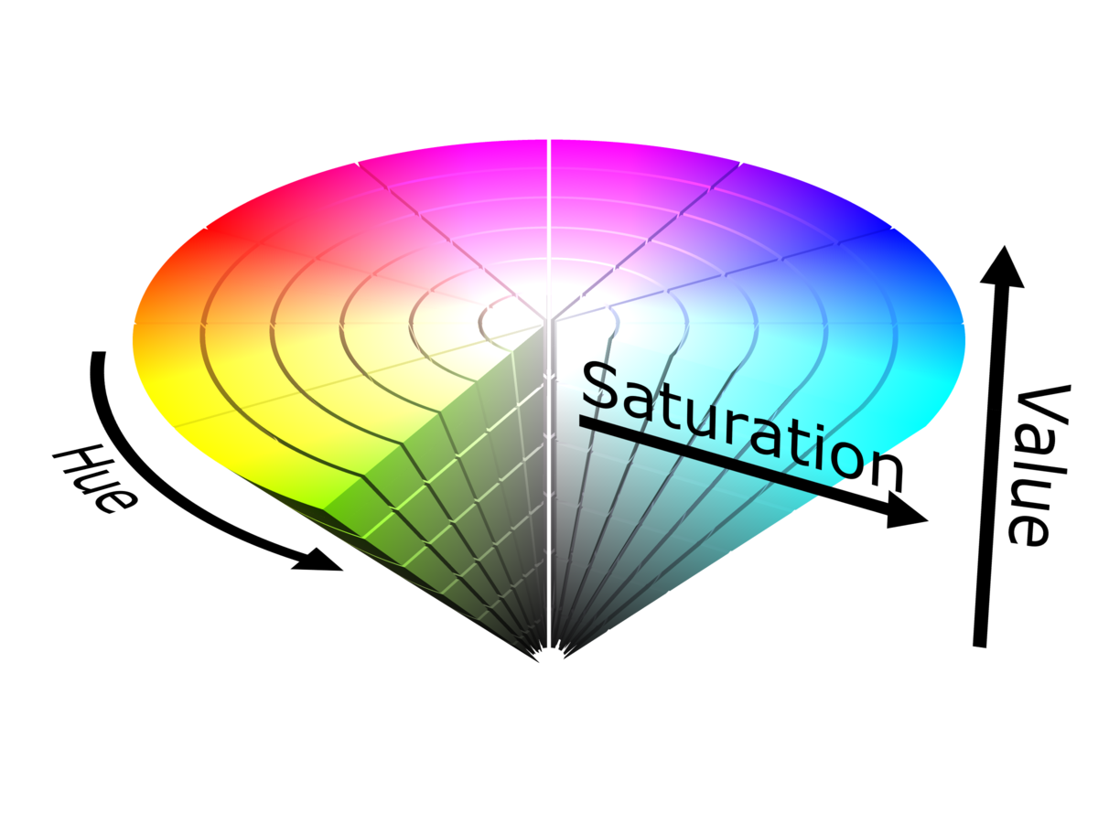
Hsv color space
Hue, Saturation and Value
Colors are represented in a way humans perceive them.
Hue – Color Value (0 – 179)
Saturation – Vibrancy of Color (0 – 255)
Value – Brightness or Intensity (0 – 255)

Slide 20
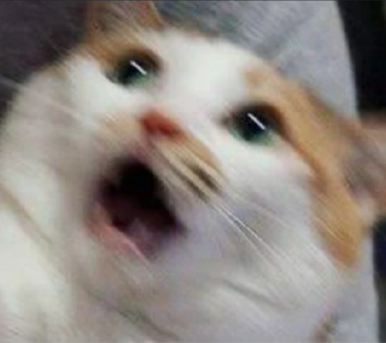
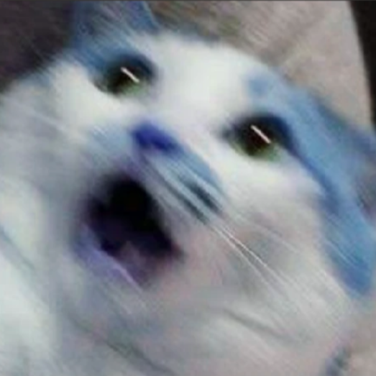
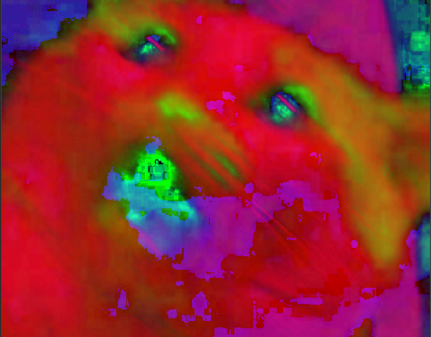
Changing Colorspaces

Slide 21
Changing Colorspaces
new_img = cv2.cvtColor(old_img, flag) #convert from one color space to another
Some Examples for flag:
cv2.COLOR_BGR2GRAY converts BGR image to Grayscale.
cv2.COLOR_BGR2RGB converts BGR to RGB image.
cv2.COLOR_BGR2HSV converts BGR to HSV.

Slide 22
ANALYSIS AND PROCESSING
For analysing the images, it is preferable to convert them to binary.
Since there is less information in binary images, it is computationally efficient.
Most of the analysis can be done on binary only
Thresholding → Conversion of grayscale to binary Masking → Conversion of colored image to binary

Slide 23
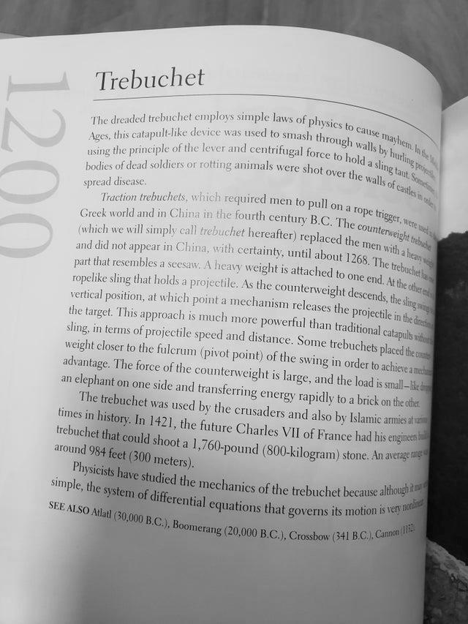
Thresholding
The pixels are partitioned depending on their gray scale values.

Slide 24
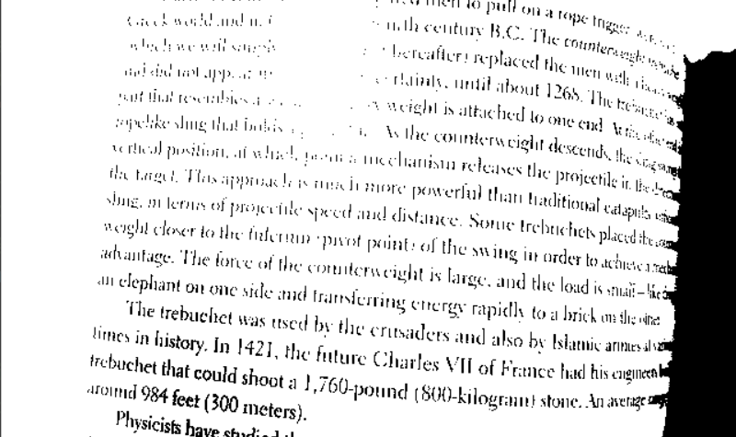
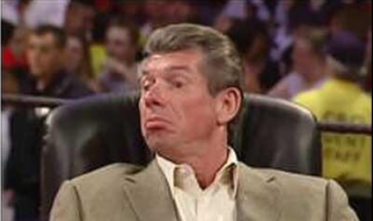
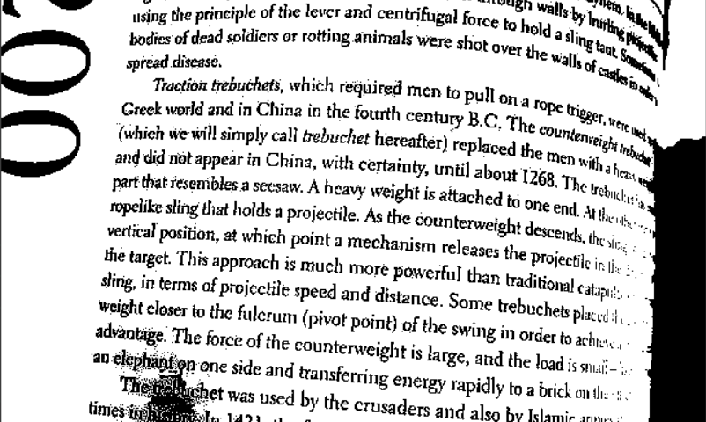

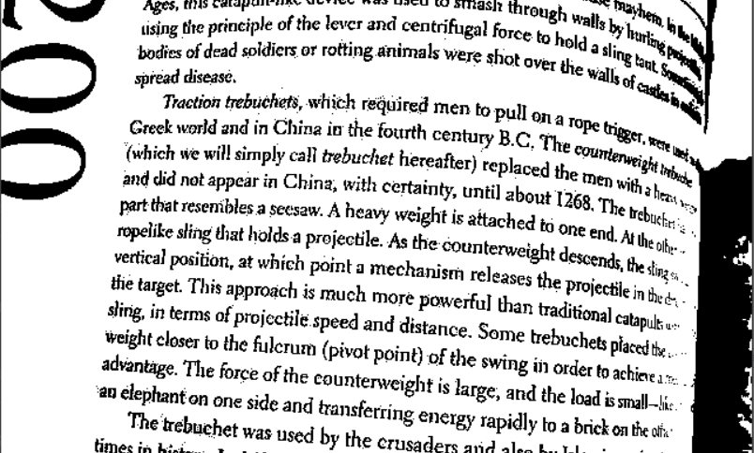
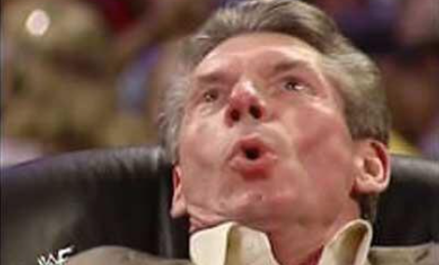
Thresholding

Slide 25
Simple Thresholding
_,threshold=cv2.threshold(img,127,255,cv2.THRESH_BINARY)
If the pixel value is greater than a threshold value (T here) then it is set to 1 otherwise it is set to 0:
1, if initial_pixel_value (x, y) > T
final_pixel_value(x, y) =
0, if initial_pixel_value (x, y) <= T
Also known as Global Thresholding.

Slide 26
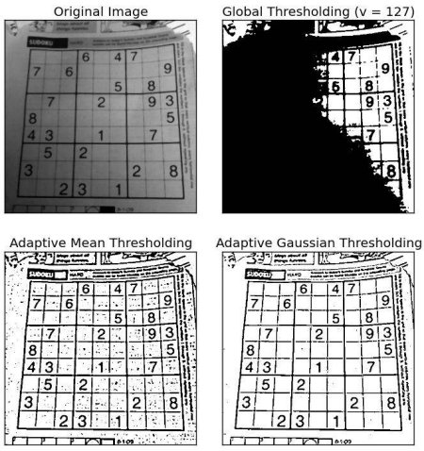

Slide 27
Simple Thresholding
_,threshold=cv2.threshold(img, 127, 255, flag)
Flags:
cv2.THRESH_BINARY: If pixel intensity is greater than the set threshold, value set to 255, else set to 0 (black).
cv2.THRESH_BINARY_INV: Inverted or Opposite case of cv2.THRESH_BINARY.
cv2.THRESH_TRUNC: If pixel intensity value is greater than threshold, it is truncated to the threshold. The pixel values are set to be the same as the threshold. All other values remain the same.
cv2.THRESH_TOZERO: Pixel intensity is set to 0, for all the pixels intensity, less than the threshold value.
cv2.THRESH_TOZERO_INV: Inverted or Opposite case of cv2.THRESH_TOZERO.

Slide 28
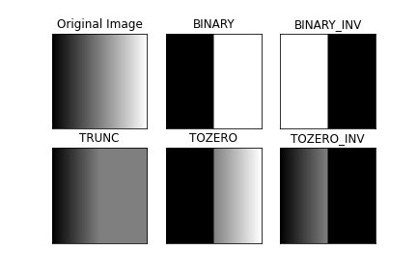

Slide 29
Adaptive Thresholding
cv2.ADAPTIVE_THRESH_MEAN_C: Threshold Value = (Mean of the neighbourhood area values – constant value). In other words, it is the mean of the blockSize×blockSize neighborhood of a point minus constant.
cv2.ADAPTIVE_THRESH_GAUSSIAN_C: Threshold Value = (Gaussian-weighted sum of the neighbourhood values – constant value). In other words, it is a weighted sum of the blockSize×blockSize neighborhood of a point minus constant.

Slide 30
Adaptive Thresholding
thresh1 = cv2.adaptiveThreshold(img, 255, cv2.ADAPTIVE_THRESH_MEAN_C, cv2.THRESH_BINARY, 199, 5)
thresh2 = cv2.adaptiveThreshold(img, 255, cv2.ADAPTIVE_THRESH_GAUSSIAN_C, cv2.THRESH_BINARY, 199, 5)

Slide 31
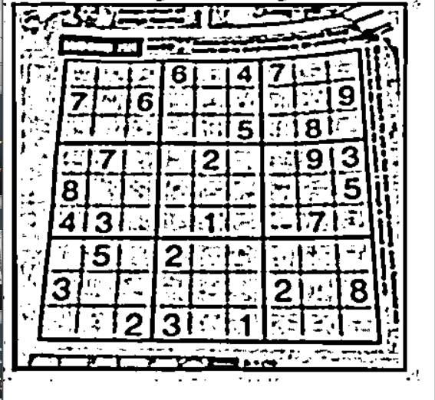
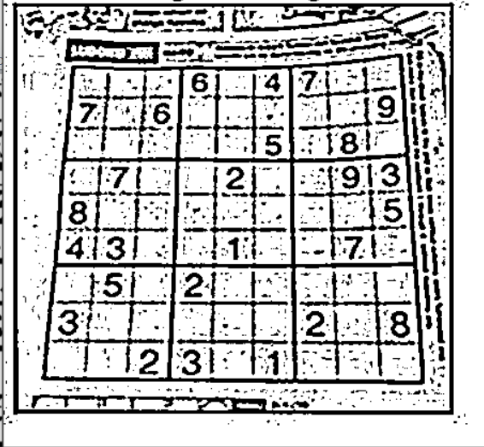
Adaptive Gaussian
Adaptive Mean

Slide 32
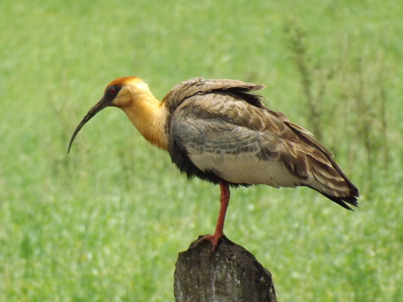
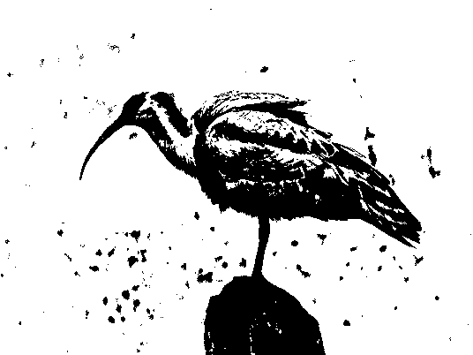
Masking:

Slide 33
Masking:
lower = np.array ([100, 200, 0])
upper = np.array ([200, 255, 55])
new_img = cv2.inRange (old_img, lower, upper)
Masking means making a binary mask for a desired color.
Masking is preferably done on HSV images because it is easy to choose color in HSV format.
We define a lower_value and an upper_value. All the colors which lie in the specified range are given value 1 in the mask and the rest are given 0.

Slide 34
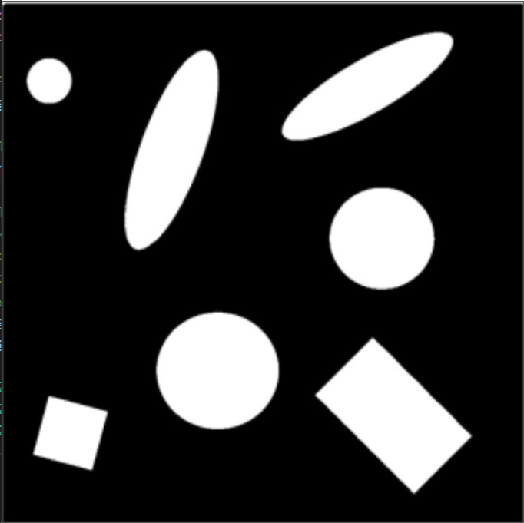
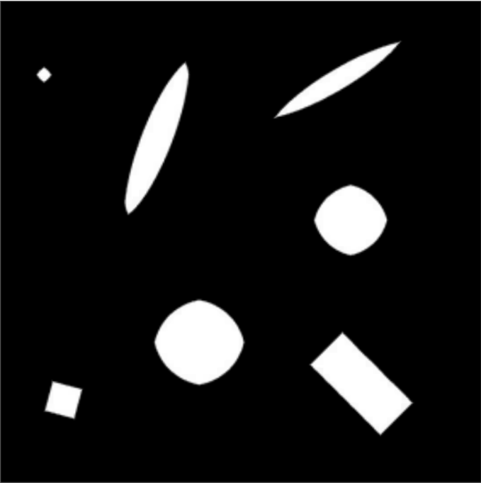
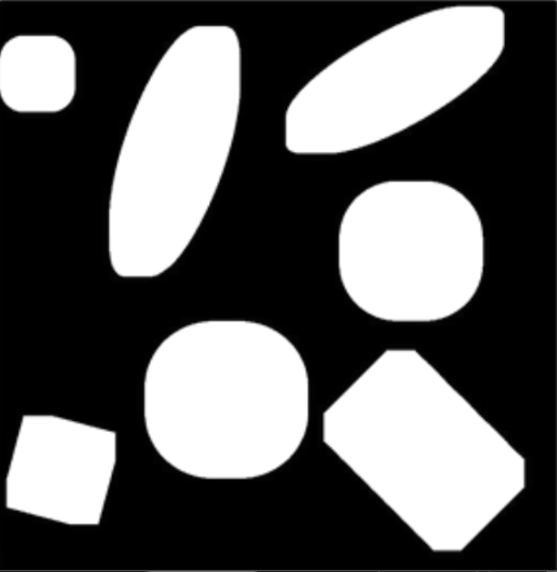
Morphological operations:
Original Eroded Dilated

Slide 35
Morphological operations:
Usually applied on binary images.
Erosion: All the pixels near the boundary will be discarded depending upon the size of the kernel.
kernel = np.ones((5, 5))
erosion = cv2.erode(img, kernel, iterations=1)
Dilation: Opposite to erosion, i.e. increases white area.
dilation = cv2.dilate(img, kernel, iterations=1)

Slide 36
Drawing on images
Line: cv2.line(image, start_point, end_point, color, thickness)
Rectangle: cv2.rectangle(image, start_point, end_point, color, thickness)
Circle: cv2.circle(image, center_coordinates, radius, color, thickness)

Slide 37
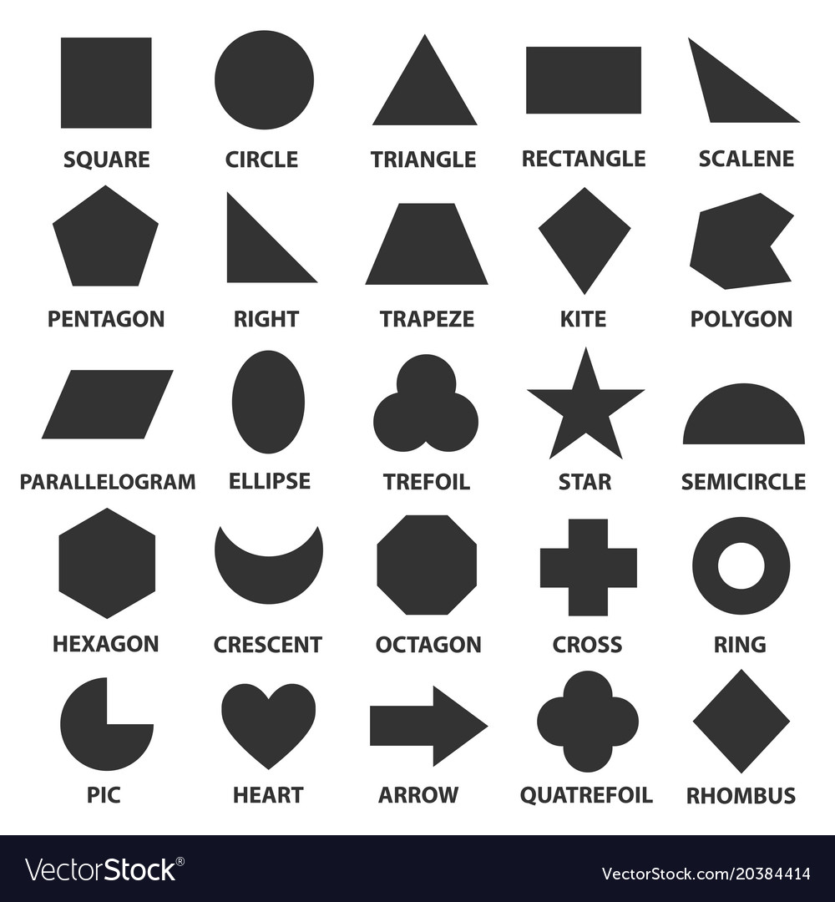
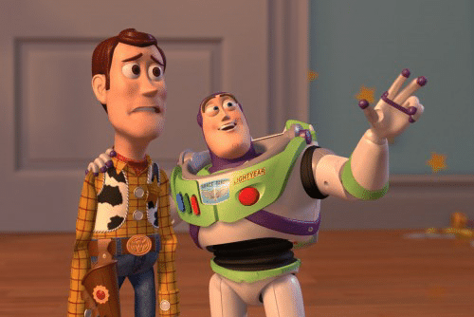
SHAPE DETECTION
Look over there
That’s a circle!!!

Slide 38
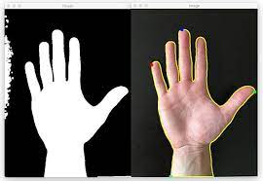
CONTOURS
A curve joining all the continuous points (along the boundary), having same color or intensity.
For better accuracy, use binary images.

Slide 39

contours, hierarchy = cv2.findContours(mask, cv2.RETR_TREE, cv2.CHAIN_APPROX_SIMPLE)
Arguments:
Source image
Contour Retrieval mode
Contour Approximation method.
CONTOUR APPROXIMATION METHOD: Contours are the boundaries of a shape. It stores the (x, y) coordinates of the boundary of a shape. But does it store all the coordinates? For e.g., if we have to find the contour of a straight line, we need just 2 end points. This is what cv2.CHAIN_APPROX_SIMPLE does. It removes all the redundant points and compresses the contour and cv2.CHAIN_APPROX_NONE gives out all the points.

Slide 40
Contours, hierarchy = cv2.findContours(mask, cv2.RETR_TREE, cv2.CHAIN_APPROX_SIMPLE)
Outputs:
Contours: Python list of all the contours found by the findContours function. Each individual contour is a numpy array of (x, y) coordinates of boundary points of the object.
Hierarchy: Optional output vector containing information about the image topology.

Slide 41
DRAWING CONTOURS
cv2.drawContours(img, contours, -1, (0, 255, 0), 3)
Arguments:
Source image
Python list of contours
Index of contours (-1 to draw all contours)
Color
Thickness

Slide 42
To draw all the contours in an image:
cv2.drawContours(img, contours, -1, (0, 255, 0), 3)
To draw an individual contour, say 4th contour:
cv2.drawContours(img, contours, 3, (0, 255, 0), 3)
But most of the time, below method is useful:
cnt = contours[4]
cv2.drawContours(img, [cnt], 0, (0, 255, 0), 3)

Slide 43


Contours features
What are moments in physics?
It is a weighted average of image pixel intensities and we can get the centroid or spatial information from the image moment.
We will use it to calculate centroid.
$M_{ij}=\sum_{x}{\sum_{y}{x^{i}y^{j}I(x, y)}}$
Centroid:
cx = int(M[‘m10’]/M[‘m00’])
cy = int(M[‘m01’]/M[‘m00’])
M = cv2.moments(contours[0])

Slide 44

Contour features
Area: Contour area is given by the function cv2.contourArea() or from moments, M[‘m00’].
Area = cv2.contourArea(contours[index])
Perimeter: Contour perimeter is given by the function cv2.arclength()
Perimeter = cv2.arcLength(contours[index], True)
Second argument specifies whether shape is a closed contour (if passed True), or just a curve.

Slide 45

Contour features - Bounding Rectangle
Bounding Rectangle: It is the rectangle that will enclose the contour. It is of two types:
Straight Bounding rectangle: It is a straight rectangle, it doesn’t consider the rotation of the object. So area of the bounding rectangle won’t be minimum. It is found by the function cv2.boundingRect().
Let (x, y) be the top-left coordinate of the rectangle and (w, h) be its width and height.
x,y,w,h = cv2.boundingRect(cnt)
img = cv2.rectangle(img, (x, y), (x+w, y+h), (0, 255, 0), 2)

Slide 46

Contour features - Min Area Rectangle
Minimum Area Rectangle: Here, bounding rectangle is drawn with minimum area, so it considers the rotation also.
The function used is cv2.minAreaRect(). It returns a Box2D structure which contains the following details – (top-left corner (x, y), (width, height), angle of rotation).
But to draw this rectangle, we need 4 corners of the rectangle. It is obtained by the function cv2.boxPoints()
rect = cv2.minAreaRect(cnt)
box = cv2.boxPoints(rect)
box = np.int0(box)
im = cv2.drawContours(img, [box], -1, (0,0,255), 2)

Slide 47
Contour approximation
It approximates a contour shape to another shape with less number of vertices depending upon the precision we specify.
To understand this, suppose you are trying to find a square in an image, but due to some problems in the image, you didn’t get a perfect square, but a ‘bad shape’.
Now, you can use this function to approximate the shape. In this, second argument is called epsilon, which is maximum distance from contour to approximated contour. It is an accuracy parameter. A wise selection of epsilon is needed to get the correct output.
Third argument specifies whether curve is closed or not.

Slide 48

Contour approximation (contd.)
epsilon = 0.1 * cv2. arcLength(contours[index], True)
approx = cv2.approxPolyDP(contours[index], epsilon, True)
Epsilon sets approximation accuracy.
Below, in second image, green line shows the approximated curve for epsilon = 10% of arc length. Third image shows the same for epsilon = 1% of the arc length.

Slide 49



Epsilon is 5 Original Image Epsilon is 20
More the epsilon, more is the approximation.

Slide 50
Detecting shapes using contour approximation
We can use the fact that triangle has three vertices, rectangle has four vertices and so the remaining ones will be circles.
img = cv2.imread(“shapes.jpg”, cv2.IMREAD_GRAYSCALE)
_, threshold = cv2.threshold(img, 240, 255, cv2.THRESH_BINARY)
_, contours, _ = cv2.findContours(threshold, cv2.RETR_TREE, cv2.CHAIN_APPROX_SIMPLE)
for cnt in contours:
approx = cv2.approxPolyDP(cnt, 0.01*cv2.arclength(cnt, True), True)
if len(approx) == 3:
print(“Triangle it is!”)
elif len(approx) == 4:
print(“Rectangle it is!”)
else:
print(“Circle it is!”)

Slide 51

Detecting shapes using some other methods
Most of the simple geometrical shapes have some properties associated with them.
Let’s take an example:
For a circle, (area/(perimeter)²) is a constant equal to (1/(4*pi)).
Do the same thing for squares.

Slide 52

Video Processing:
Videos are extension of images in 4th dimension.
Frames can be BGR image or Grayscale or Binary image.

Slide 53

Video Processing:
Take a video
Do processing on each image as an individual frame
Output the processed image
Read the video
Separate frames from the video
Make an output video out of processed images

Slide 54

Video Processing:
To capture a video, you need to create a VideoCapture object.
Its argument can be either the device index or the name of a video file.
cap = cv2.VideoCapture(0)

Slide 55
video = cv2.VideoCapture('begin.mkv')
while True:
ret,img = video.read()
if ret == False:
break
# Processing Here
cv2.imshow('vid',img)
k=cv2.waitKey(1)
if(k==ord(‘q’)):
cap.release()
cv2.destroyAllWindows
break

Slide 56

Thank you

